Slide 1
Clustering stations in London based on Arts & Entertainment venues

Slide 2

Clustering stations this way helps tourists
Filter stations based on their preferred venue types
Better plan their trips
Choose an optimal hotel location
Gain a better understanding of the city

Slide 3
Data Acquisition & Cleaning
Station data was collected from doogal.co.uk
Venue information was collected using the Foursquare API
Only stations in zones 1 and 2 were kept
Stations with less that four unique venue categories were removed
Total of 117 stations across London

Slide 4
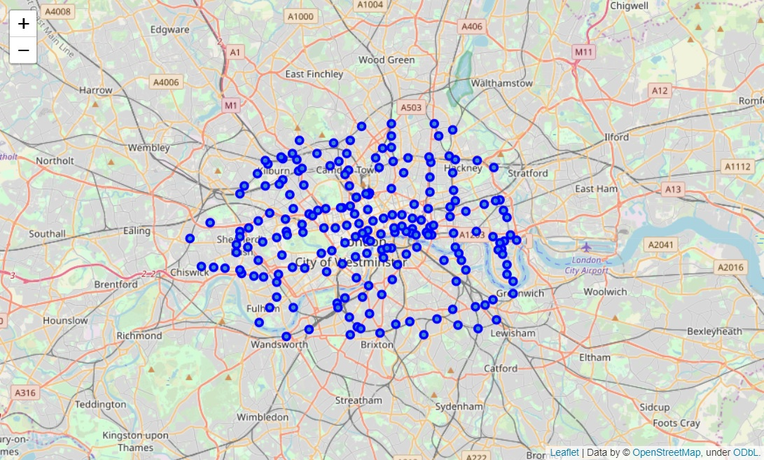
Original stations before data cleaning

Slide 5
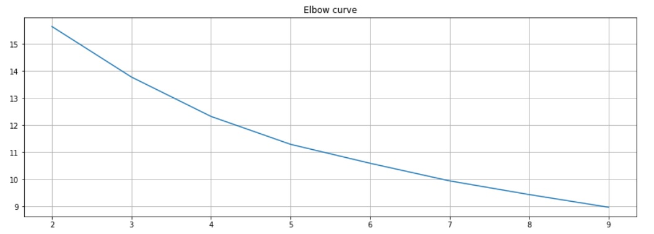
K-Means was run
Performed one hot encoding
Got the frequency for the top 4 categories
Implemented k-means for 5 clusters since elbow curve was inconclusive
Run for a total of 12 times with different centroid seeds

Slide 6
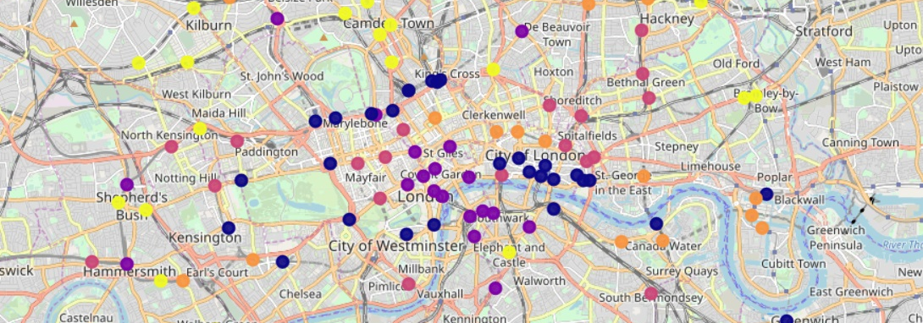
Clustering had interesting results
Stations were spread-out almost evenly across clusters
The five main categories were: ‘Music Venues’, ‘Museums’, ‘Art Galleries’, ‘Movie Theatres’ and ‘Theatres’

Slide 7
Conclusions
Arts & Entertainment venues are an effective way of clustering the stations in London
Tourists can gain valuable insight and better plan their trips
Further improvements can be made (e.g. selecting station and visualising its venues)

